Slide 1

Principles of Marketing
Module 1: What Is Marketing?
Notes:
All text in these slides is taken from https://courses.lumenlearning.com/wmopen-principlesofmarketing/, where it is published under one or more open licenses.
All images in these slides are attributed in the notes of the slide on which they appear and licensed as indicated.
Cover Image: "Shopping freak." Provided by: freestocks.org. Located at: https://unsplash.com/photos/_3Q3tsJ01nc. Content Type: CC Licensed Content, Shared Previously. License: CC0: No Rights Reserved.

Slide 2
What is Marketing?
Marketing is a set of activities related to creating, communicating, delivering, and exchanging offerings that have value for others

Slide 3
History of Evolution of the Marketing Concept
The Product Concept
Success depends on creating the best, most innovative product for the lowest price
The Sales Concept
Success depends on a good sales team with the right tools and incentives.
The Production Concept
Success depends on low production costs, highly efficient processes, and mass distribution.
The Marketing Concept
Success depends on doing better than competitors at understanding, creating, delivering, and communicating value to their target customers
Notes:
The Marketing Concept
Success depends on doing better than competitors at understanding, creating, delivering, and communicating value to their target customers
The Product Concept
Success depends on creating the best, most innovative product for the lowest price
The Sales Concept
Success depends on a good sales team with the right tools and incentives.
The Production Concept
Success depends on low production costs, highly efficient processes, and mass distribution.

Slide 4
The Exchange Process
The act of obtaining a desired object from someone by offering something of value in return
Customer (or buyer)
Product
Provider (or seller)
Transaction

Slide 5
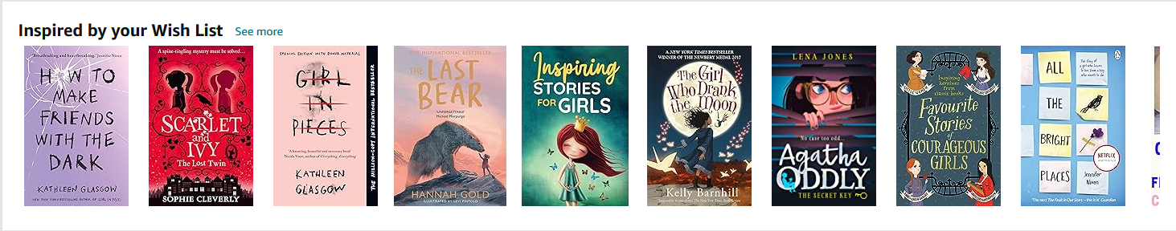
What is the function of marketing?
Marketing brings value to customers, whom the business seeks to identify, satisfy, and retain.
Notes:
Screen shot of Amazon unicorn recommendations. Provided by: Amazon. License: All Rights Reserved. License Terms: Fair Use

Slide 6
Goals of Marketing
For profit companies
Not for profit organizations
Increase profits by selling products or services to customers
Promote the mission by attracting donors or participants or by raising awareness of an issue or cause

Slide 7
Difference Between Customers and Consumers
Customers are the individuals who buy the product
Consumers are the individuals who actually use the product
The customer and the consumer are not always the same
Example: A food distributor’s customer is the restaurant, not the diner who is the consumer

Slide 8
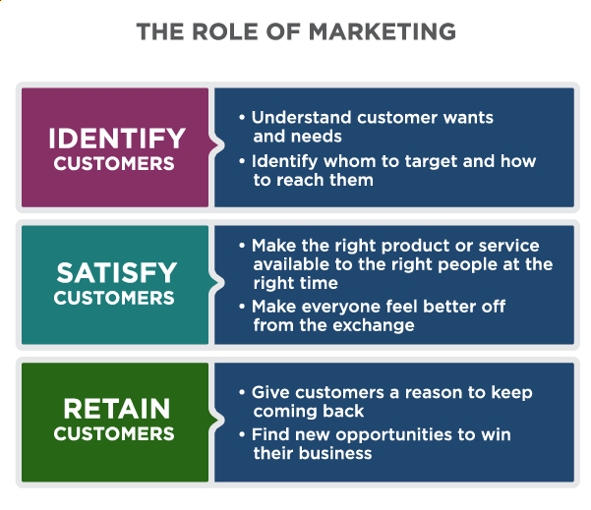
The Role of Marketing
Notes:
What Is Marketing?, Marketing Creates Value for Customers. Authored by: Lumen Learning. License: CC BY: Attribution

Slide 9
Relationship Stages
Meeting and Getting Acquainted
Providing a Satisfying Experience
Sustaining a Committed Relationship

Slide 10
Stage 1: Meeting and Getting Acquainted
Find desirable target customers, including those likely to deliver a high customer lifetime value
Understand what these customers want
Build awareness and demand for what you offer
Capture new business

Slide 11
Stage 2: Providing a Satisfying Experience
Measure and improve customer satisfaction
Track how customers’ needs and wants evolve
Develop customer confidence, trust, and goodwill
Demonstrate and communicate competitive advantage
Monitor and counter competitive forces

Slide 12
Stage 3: Sustaining a Committed Relationship
Convert contacts into loyal repeat customers, rather than one-time customers
Anticipate and respond to evolving needs
Deepen relationships, expand reach of and reliance on what you offer

Slide 13

What is Customer Lifetime Value?
Customer lifetime value predicts how much profit the company will make from the customer during his or her lifetime relationship with the company ^{[1]}
Notes:
Lady on a Staircase. Authored by: torbakhopper. Located at: https://www.flickr.com/photos/gazeronly/10147130996/. License: CC BY-ND: Attribution-NoDerivatives
[1] "Customer Lifetime Value." Cambridge Dictionary. Accessed September 10, 2019. http://dictionary.cambridge.org/us/dictionary/english/customer-lifetime-value

Slide 14
How Do Strong Customer Relationships Help a Business?
Happy customers . . .
Return to buy more goods and services
Help market the business with positive reviews or word of mouth
Engage with the brand

Slide 15
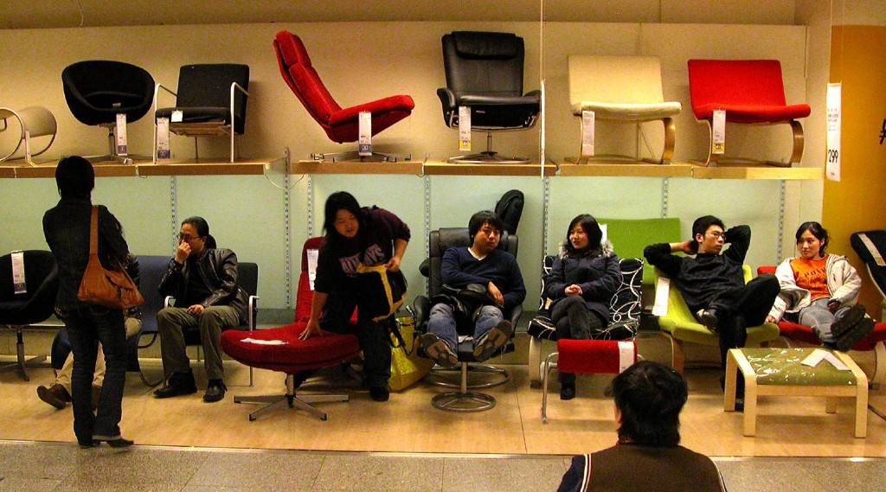
B2B vs. B2C
B2B or Business to Business companies sell products or services to other businesses
B2C or Business to Consumer companies sell directly to consumers
Notes:
IKEA, Bejing. Authored by: Peter Morgan. Located at: https://www.flickr.com/photos/pmorgan/5517848/. License: CC BY-NC-ND: Attribution-NonCommercial-NoDerivatives

Slide 16
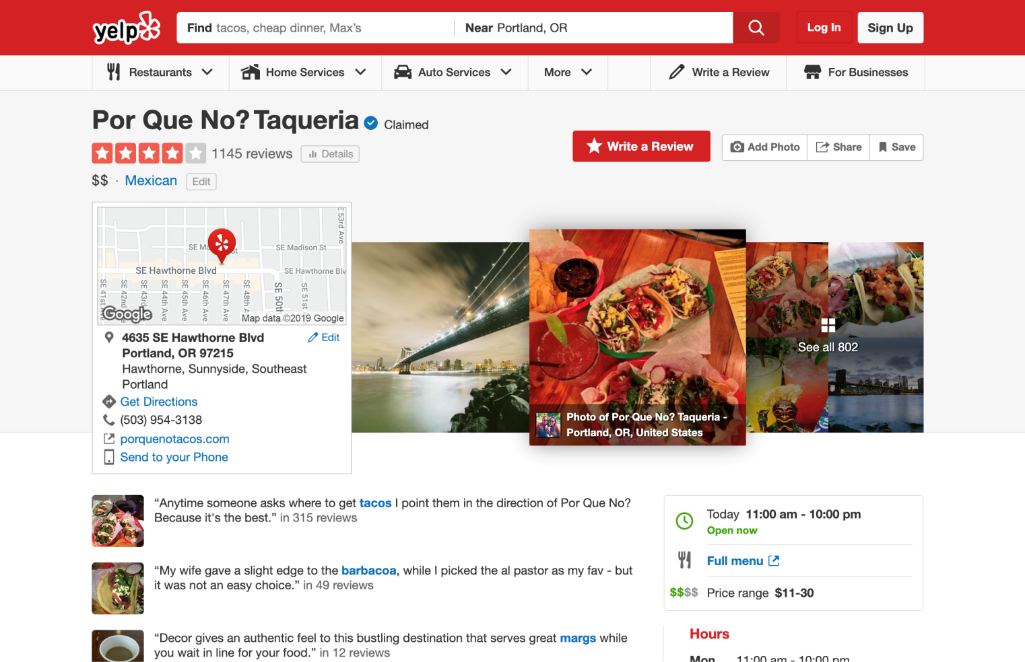
How does Marketing Serve Customers?
Marketing can help customers find goods and services that are valuable to them
Notes:
Screen Shot of Yelp Review. Authored by: Yelp.com. Located at: https://www.yelp.com/biz/por-que-no-taqueria-portland. License: All Rights Reserved. License Terms: Fair Use

Slide 17
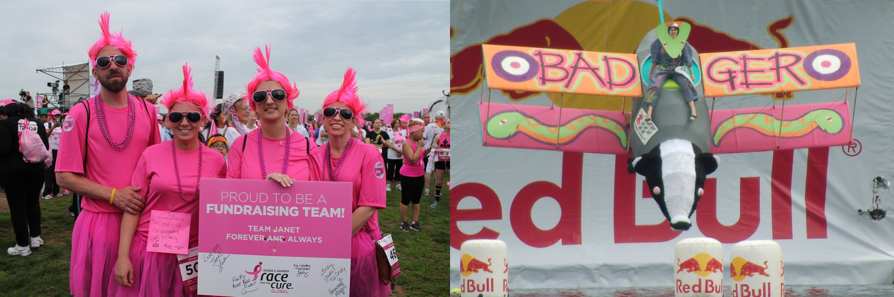
How Does Marketing Serve Society?
Marketing helps customers and businesses find each other to make exchanges that benefit them both
Marketing can spread ideas and innovation
Notes:
Global Race for the Cure. Authored by: Elvert Barnes. Located at: https://www.flickr.com/photos/perspective/13987275038/. License: CC BY-SA: Attribution-ShareAlike
Flugtag (22). Authored by: Helen Crook. Located at: https://www.flickr.com/photos/lalalen/2565923132/. License: CC BY-NC-ND: Attribution-NonCommercial-NoDerivatives

Slide 18
Marketing vs. Advertising
Advertising uses paid notices in different forms of media to draw public attention to a company, product, or message, usually for the purpose of selling products or services [1]
Advertising is one of many tools marketers use
Notes:
[1] "Advertising." The Free Dictionary. Accessed September 10, 2019. http://www.thefreedictionary.com/advertising

Slide 19
Marketing vs. Branding
Branding is the process of “creating a unique name and image for a product in the consumer’s mind” ^{[1]}
Marketing builds brands, and branding is an important strategic consideration in marketing, but marketing is broader than branding
Notes:
[1] "Branding." Business Dictionary. Accessed September 10, 2019. http://www.businessdictionary.com/definition/branding.html

Slide 20
Marketing vs. Sales
Sales is the process of actually selling products or services
Effective marketing aligns well with the sales process and leads to increased sales, but there is more to marketing than just supporting sales

Slide 21
Quick Review
What is marketing?
Where do you experience marketing in everyday life?
What are the differences between marketing, branding, advertising, and sales?
What is the marketing concept? How does it differ from the production concept, the product concept, or the selling concept?
What is the role of marketing in building and managing customer relationships?
How do different types of organizations, such as non-profits, consumer product (B2C) firms and business-to-business (B2B) organizations, use marketing?
How does marketing create value for the consumer, the company, and society?

Slide 22
Segmentation and Targeting
Segmentation is the process of dividing potential customers into groups to better understand them
Targeting is determining which segments are most likely to become customers and directing marketing efforts to best to satisfy them

Slide 23
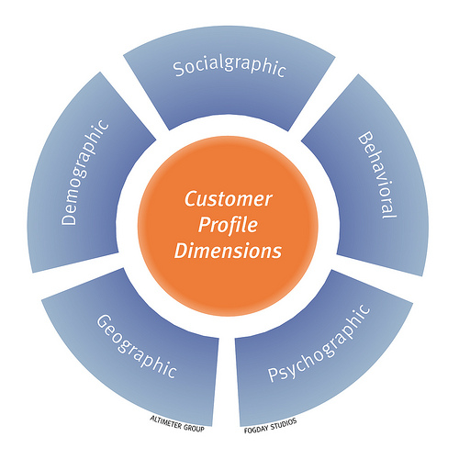
Defining a Target Market
Identify the business need you address
Segment your total market
Profile your target customer segment(s)
Research and validate your market opportunity
Notes:
Customer Profile Dimensions. Authored by: fogfish. Located at: https://www.flickr.com/photos/fogfish/4404316225. License: CC BY-SA: Attribution-ShareAlike

Slide 24
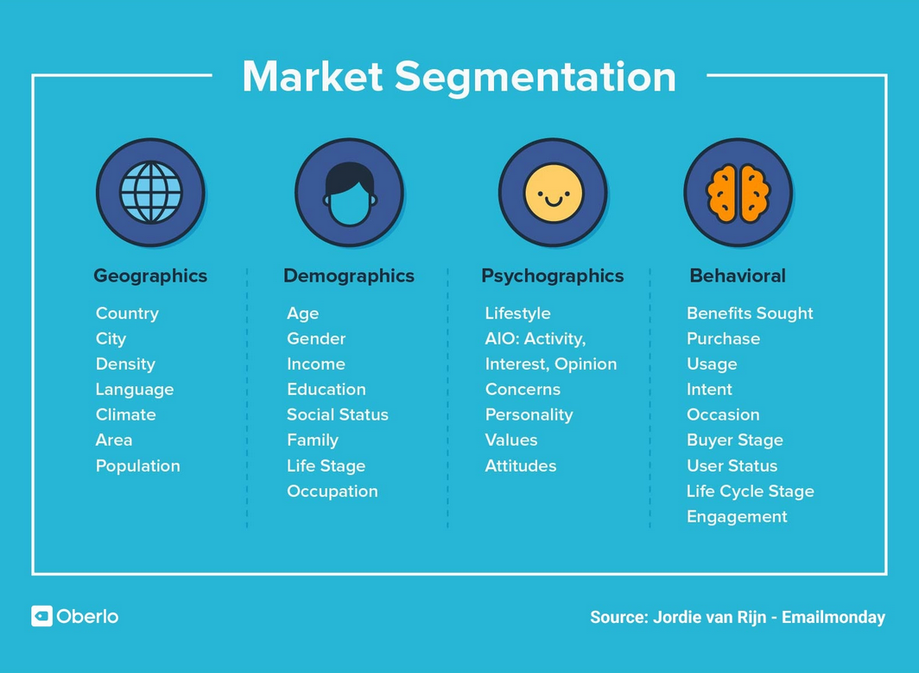

Slide 25
Value for the Customer
Value = benefit – cost
Price is only part of cost
Customers will consider competitors and substitutes
Differentiation is how marketers optimize the elements of a product that provide unique value to customers
When a company can create greater value for customers than its competitors, it has a competitive advantage

Slide 26
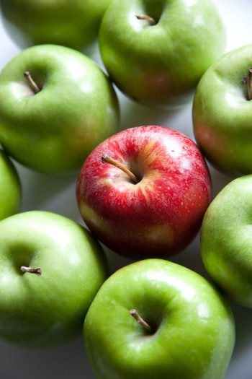
Value Proposition
A value proposition provides a very simple answer to the question: Why should someone buy what you are offering?
The value proposition should be clear, compelling, and differentiating
Notes:
Apples--Stand Out. Authored by: Flazingo Photos. Located at: https://www.flickr.com/photos/124247024@N07/14086869112/. License: CC BY-SA: Attribution-ShareAlike

Slide 27
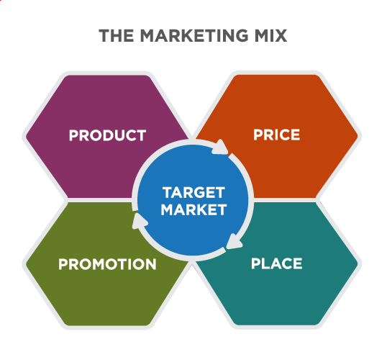
The Marketing Mix
Notes:
Defining the Marketing Mix. Provided by: Lumen Learning. License: CC BY-SA: Attribution-ShareAlike

Slide 28
Evolving Definitions of the Marketing Mix
4 Ps
4 Cs
Product
Price
Promotion
Place
Consumer solution
Cost
Communication
Convenience
Notes:
Adapted from 4 Ps and 4 Cs chart. Provided by: Wikipedia. Located at: https://en.m.wikipedia.org/wiki/Marketing_mix#Lauterborn.27s_four_Cs. License: CC BY-SA: Attribution-ShareAlike

Slide 29
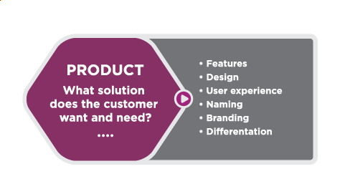
Product

Slide 30
Product vs Customer Solution
A company will only sell what the consumer specifically wants to buy. So, marketers should study consumer wants and needs to attract them.
The product includes:
Quality
Specific features
Packaging/presentation
Branding
Social or environmental causes supported by the purchase of the product
The problem that it will solve for your customers
Notes:
Adapted from 4 Ps and 4 Cs chart. Provided by: Wikipedia. Located at: https://en.m.wikipedia.org/wiki/Marketing_mix#Lauterborn.27s_four_Cs. License: CC BY-SA: Attribution-ShareAlike

Slide 31
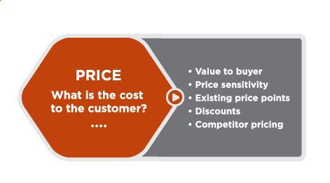
Price

Slide 32
Price vs Cost
Price is only a part of the total cost to satisfy a want or a need.
The total cost of ownership might include
Cost in terms of the money paid
Cost of time in acquiring a good or a service,
Cost of conscience in consuming it.
Cost in terms of inconvenience (waiting time, difficulty in assembling, learning how to use the new product etc.)
Opportunity cost (foregone opportunity of having wasted time or having ruined experience of a special occasion – say a wedding or 50th anniversary)
Notes:
Adapted from 4 Ps and 4 Cs chart. Provided by: Wikipedia. Located at: https://en.m.wikipedia.org/wiki/Marketing_mix#Lauterborn.27s_four_Cs. License: CC BY-SA: Attribution-ShareAlike

Slide 33
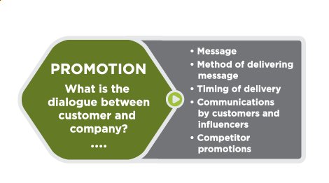
Promotion

Slide 34
Promotion vs Communication
Communications can include advertising, public relations, personal selling, viral advertising, and any form of communication between the organization and the consumer.
Promotion – a one way process
Communication – a two way process
Promotional tactics fall into two categories: traditional and digital.
Traditional methods encompass print media, broadcasting, mail, billboards, and word of mouth.
Digital avenues include email, social media, content marketing, SEO, mobile outreach, and paid ads.
Digital marketing generates 50% more customer interactions than traditional methods
Notes:
Adapted from 4 Ps and 4 Cs chart. Provided by: Wikipedia. Located at: https://en.m.wikipedia.org/wiki/Marketing_mix#Lauterborn.27s_four_Cs. License: CC BY-SA: Attribution-ShareAlike

Slide 35
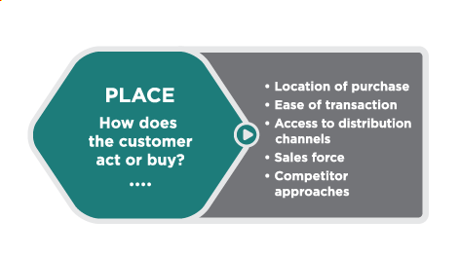
Place

Slide 36
Place vs Convenience
Marketers should know how the target market prefers to buy (at home or in retail stores, at what time of the day etc.) and be accessible noth geographically as well as temporally.
Provide convenience of buying. Convenience takes into account the ease of buying the product, finding the product, and finding information about the product.
Marketers need to use the right distribution channels
With the rise of Internet and hybrid models of purchasing, “place” is becoming less relevant.
Notes:
Adapted from 4 Ps and 4 Cs chart. Provided by: Wikipedia. Located at: https://en.m.wikipedia.org/wiki/Marketing_mix#Lauterborn.27s_four_Cs. License: CC BY-SA: Attribution-ShareAlike

Slide 37
5P’s, 7 P’s
The basic 4 P’s of marketing have been augmented by some other elements
Product
Price 4P’s
Promotion 5P’s
Place 7P’s
People
Physical Presence
Processes

Slide 38
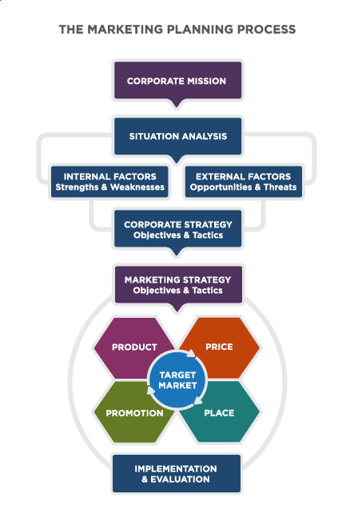
The Marketing Planning Process
Marketing Plan
The marketing plan describes how the company will use the marketing mix—product, promotion, place, and price—to achieve its marketing objectives effectively within the competitive market environment

Slide 39
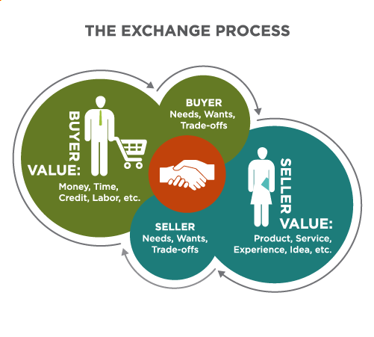
The Exchange Process
Notes:
Revision and Adaptation. Authored by: Lumen Learning. License: CC BY: Attribution

Slide 40
Theories of Consumer Behavior: The Economic Man
According to the “economic man” model, consumers are rational and narrowly self-interested, always trying to maximize the benefits they derive from the exchange process
Limitations: People are not always rational or they define value differently than this model would suggest

Slide 41
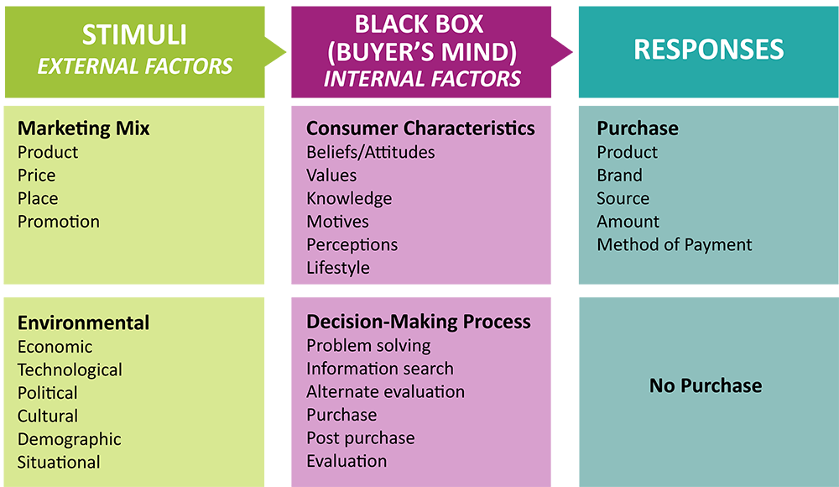
The Stimulus – Organism - Response Model
Notes:
Revision and Adaptation. Authored by: Lumen Learning. License: CC BY: Attribution

Slide 42
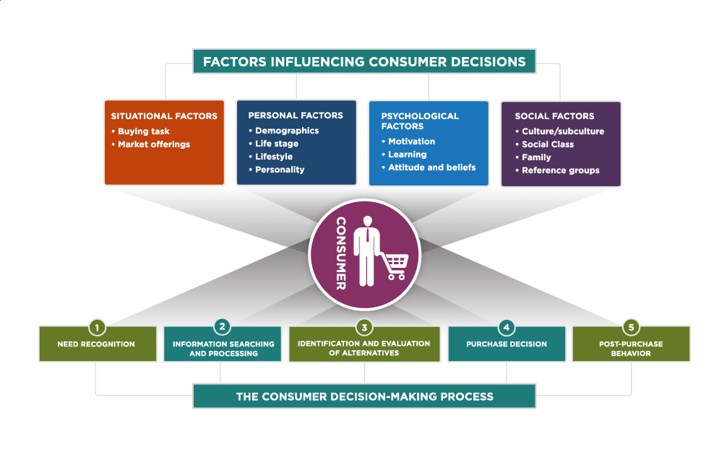
Factors Influencing Consumer Decisions and the Consumer Decision-Making Process
Notes:
Revision and Adaptation. Authored by: Lumen Learning. License: CC BY: Attribution

Slide 43
Quick Review
Why is the customer the cornerstone of marketing?
What are segmentation and targeting?
What is the marketing mix?
How do organizations use the marketing mix (often called the four Ps) to market to their target customers?
What is the role of a marketing plan in guiding marketing activities?

